Slide 1
Welcome back to Junior Jellies Summer Python

Slide 2
Now that you know Scratch, let’s start Python
Search repl.it

Slide 3
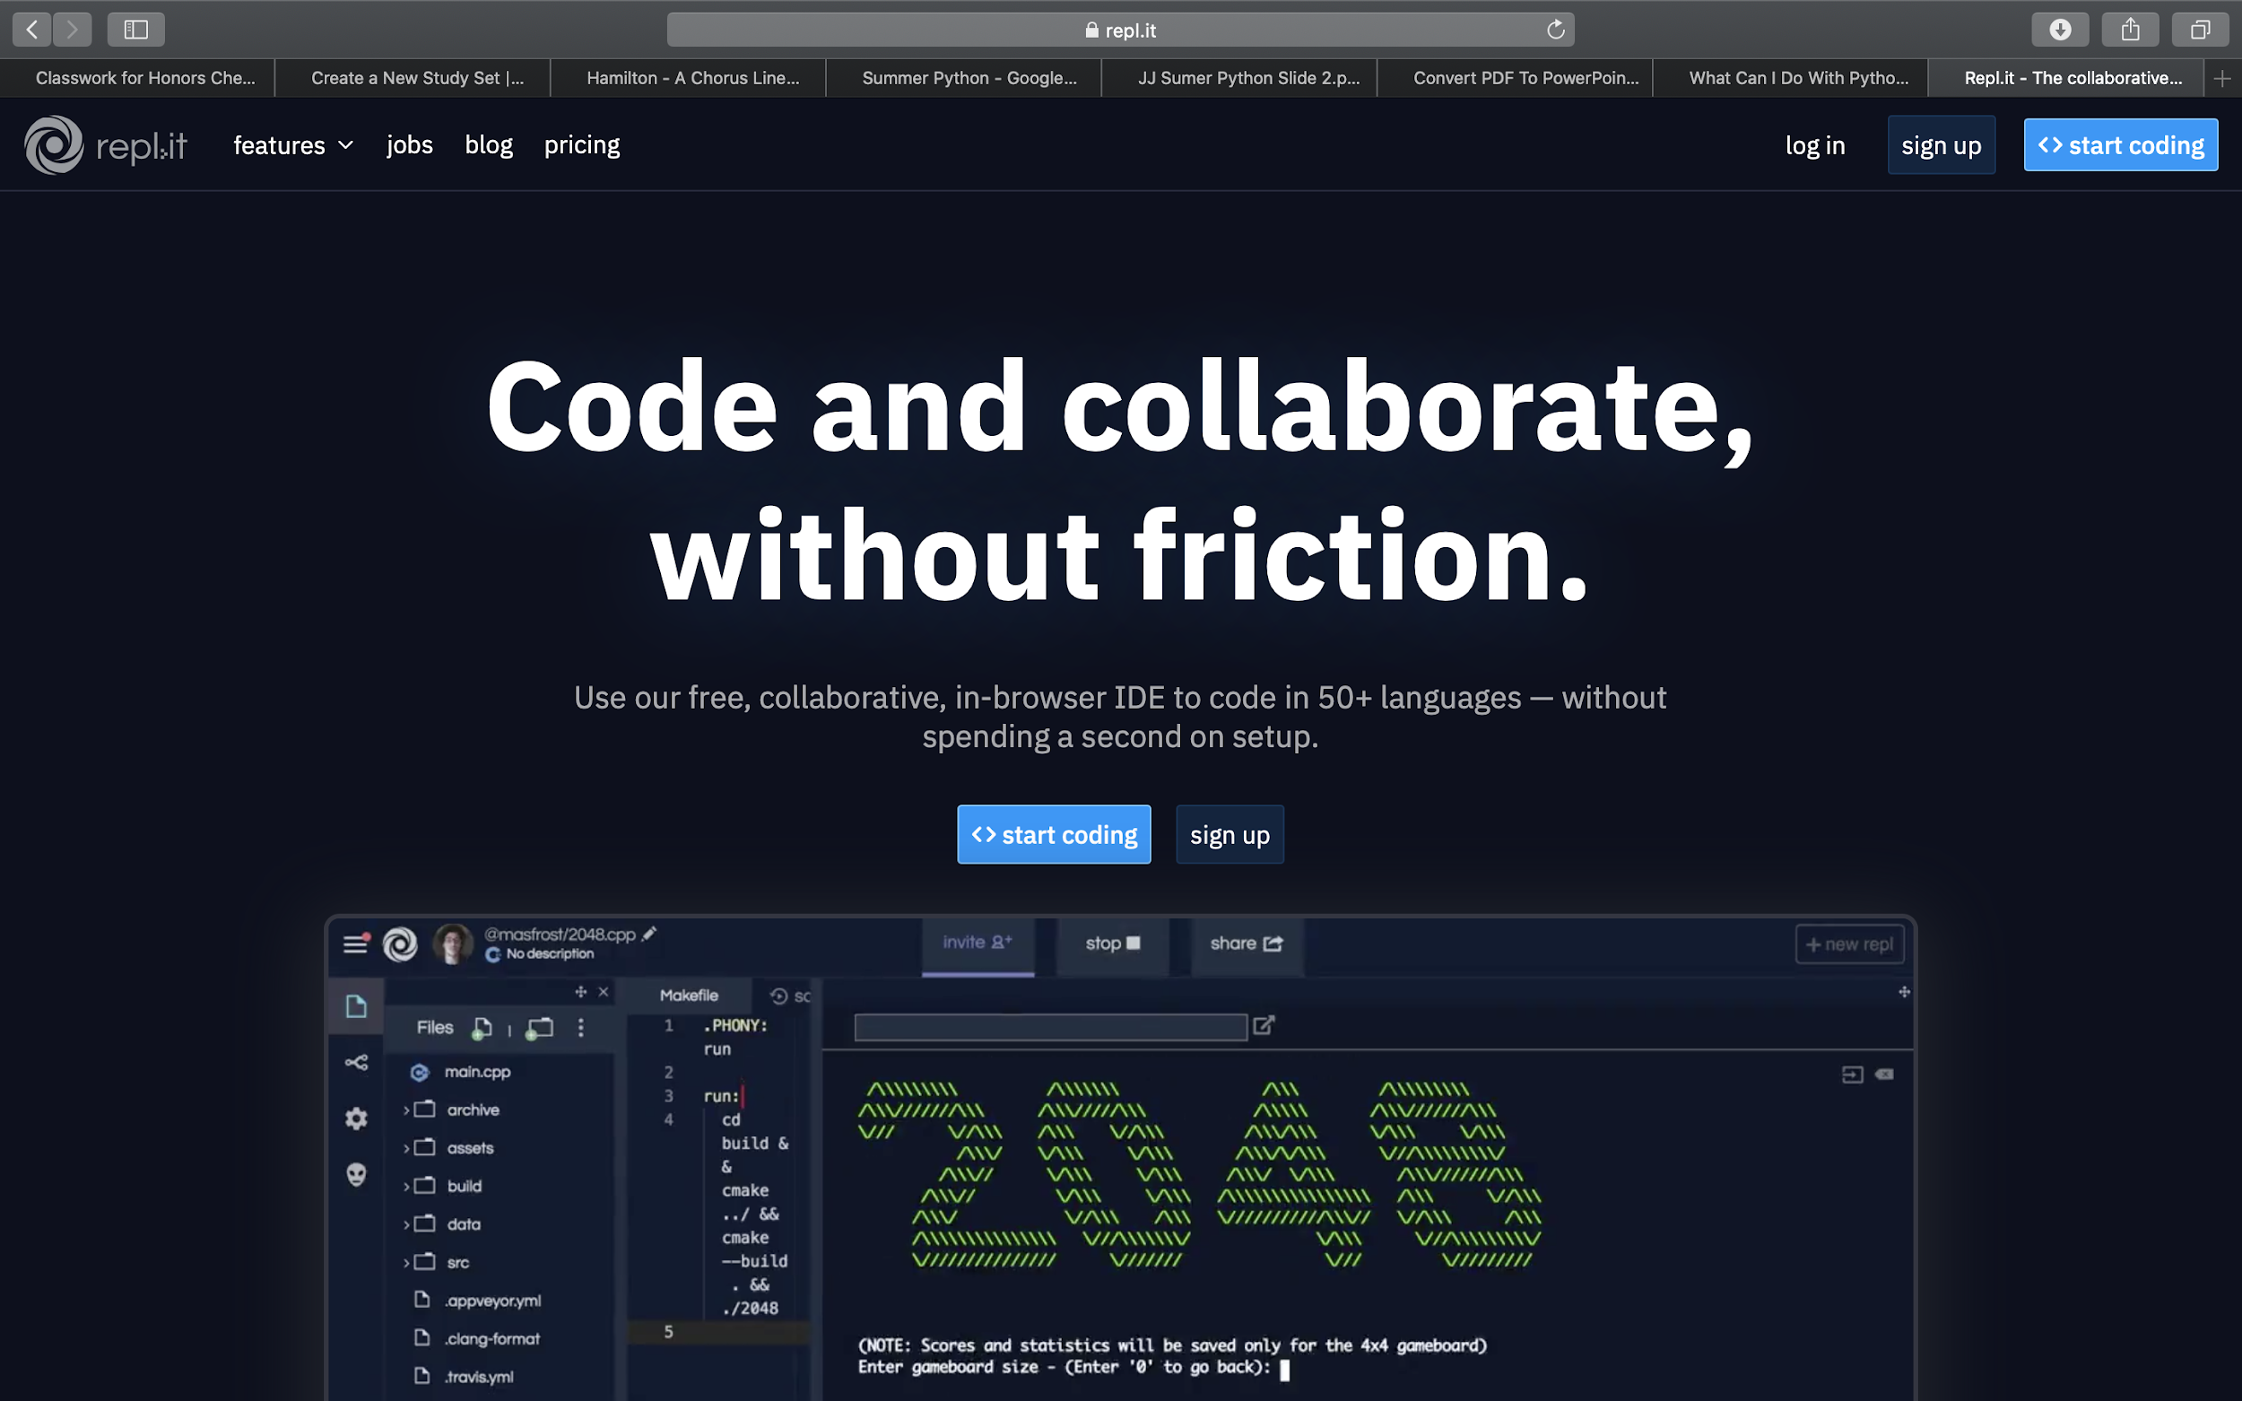
You should reach this page if you search repl.it
Repl.it is a cool site where you get to write code

Slide 4
Click
Sign
Up

Slide 5
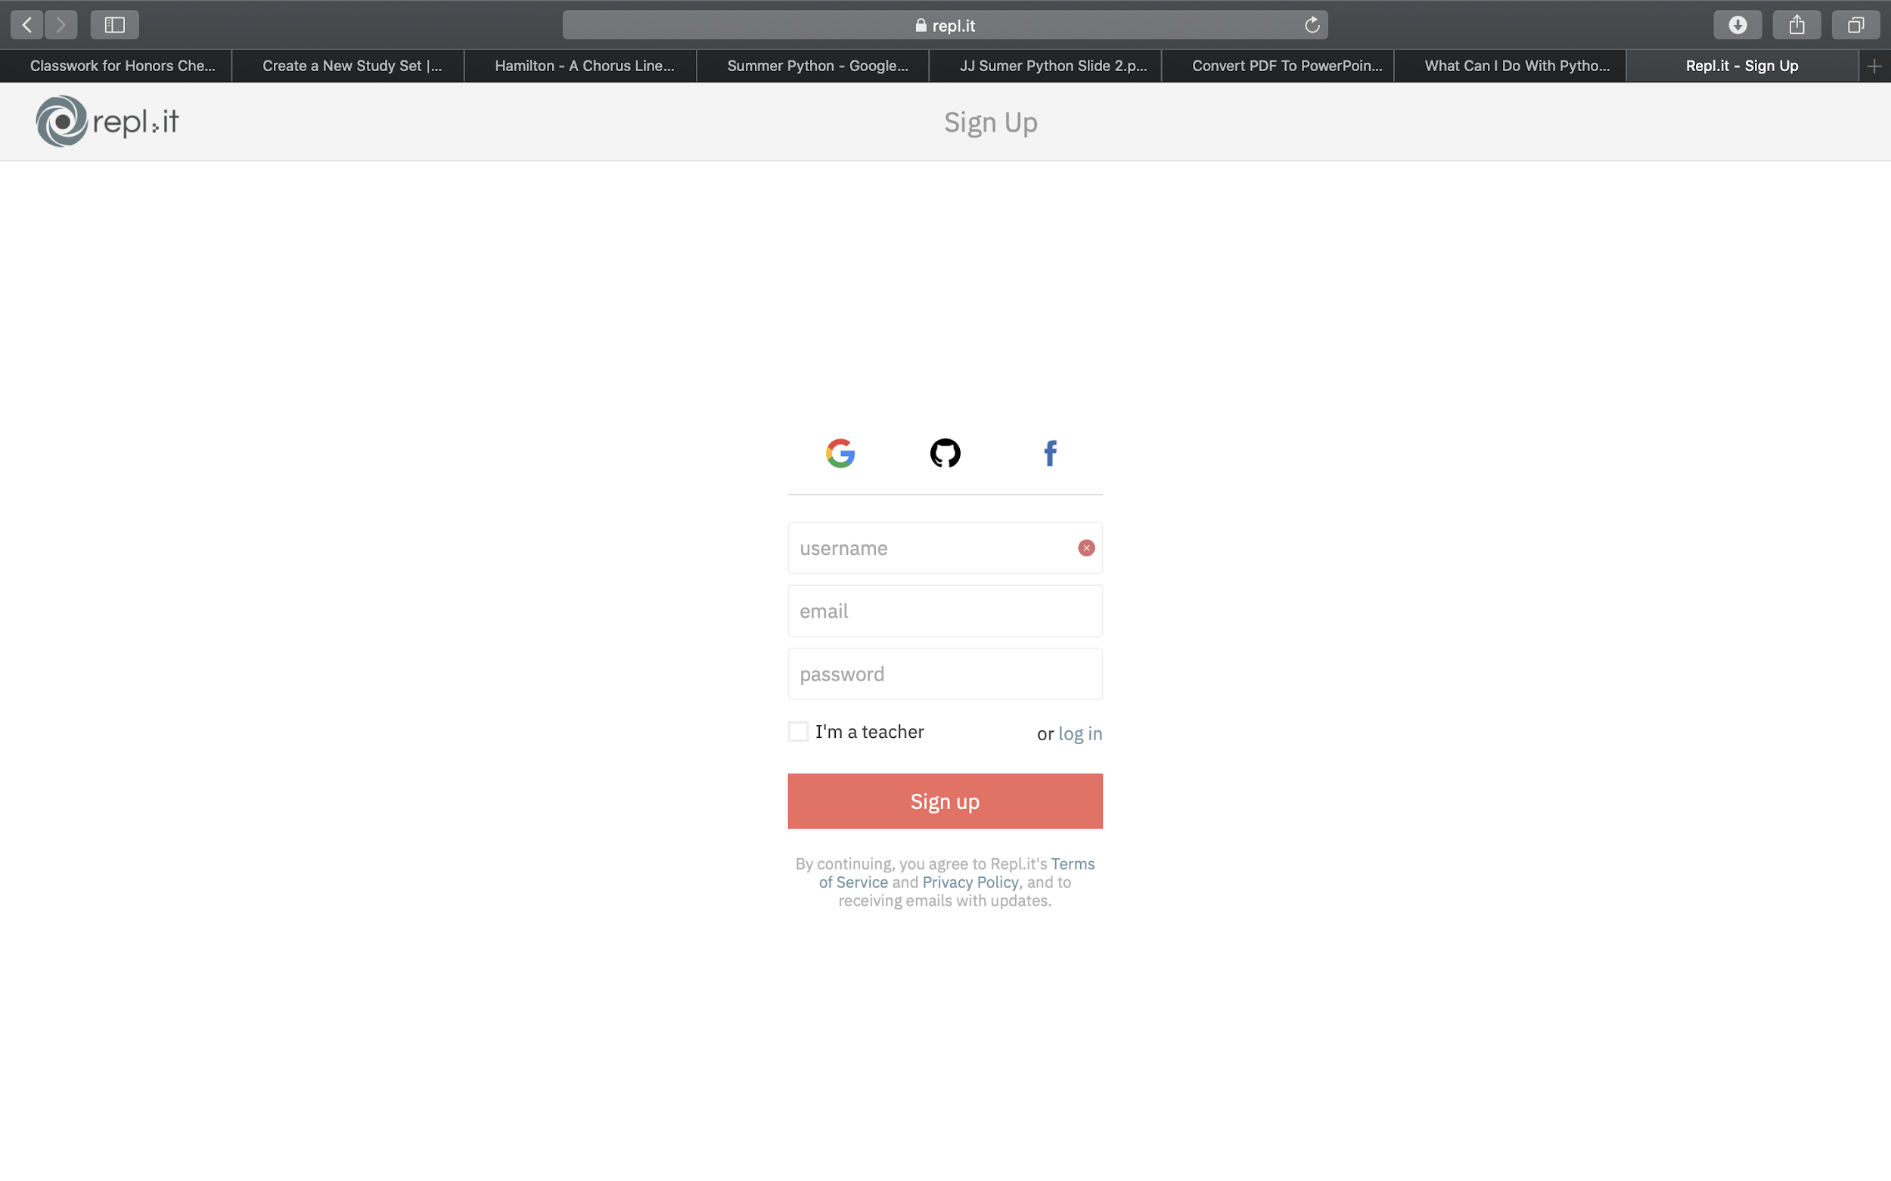
Click on the Google Sign up

Slide 6
Sign up using your school email address
Once you sign up, wait before you move on
The next part is really important

Slide 7
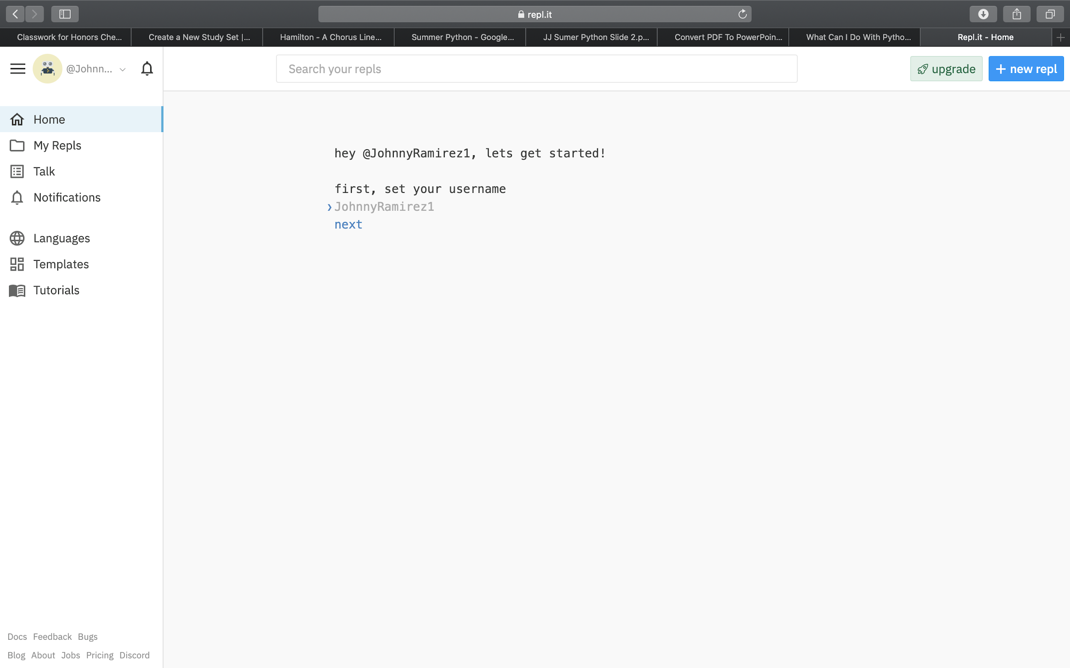
Create a username and share it with your advisor
Set your username when you reach this page. Please share or username with your advisors. Do not continue until your advisors have your username

Slide 8
After sharing your username, answer the next few questions.
If you don’t know how to answer, here’s some help:
Email Question: Click Yes
Skill Level Question: Click “Brand New”
What you are most interested in:
Click “Learning” and then click “In a school”
Language Question: Click “Python” and two others languages (you can pick, it doesn’t matter which)

Slide 9
When you finish answering all of the questions, you will get a url sent to you by one of the advisors.
Click on it
You are about to write in Python!!!

Slide 10
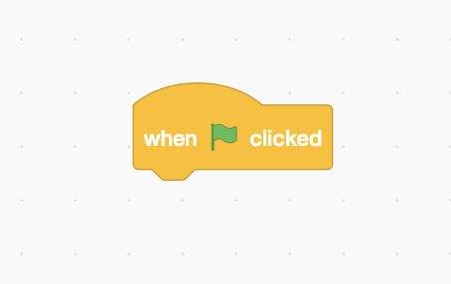
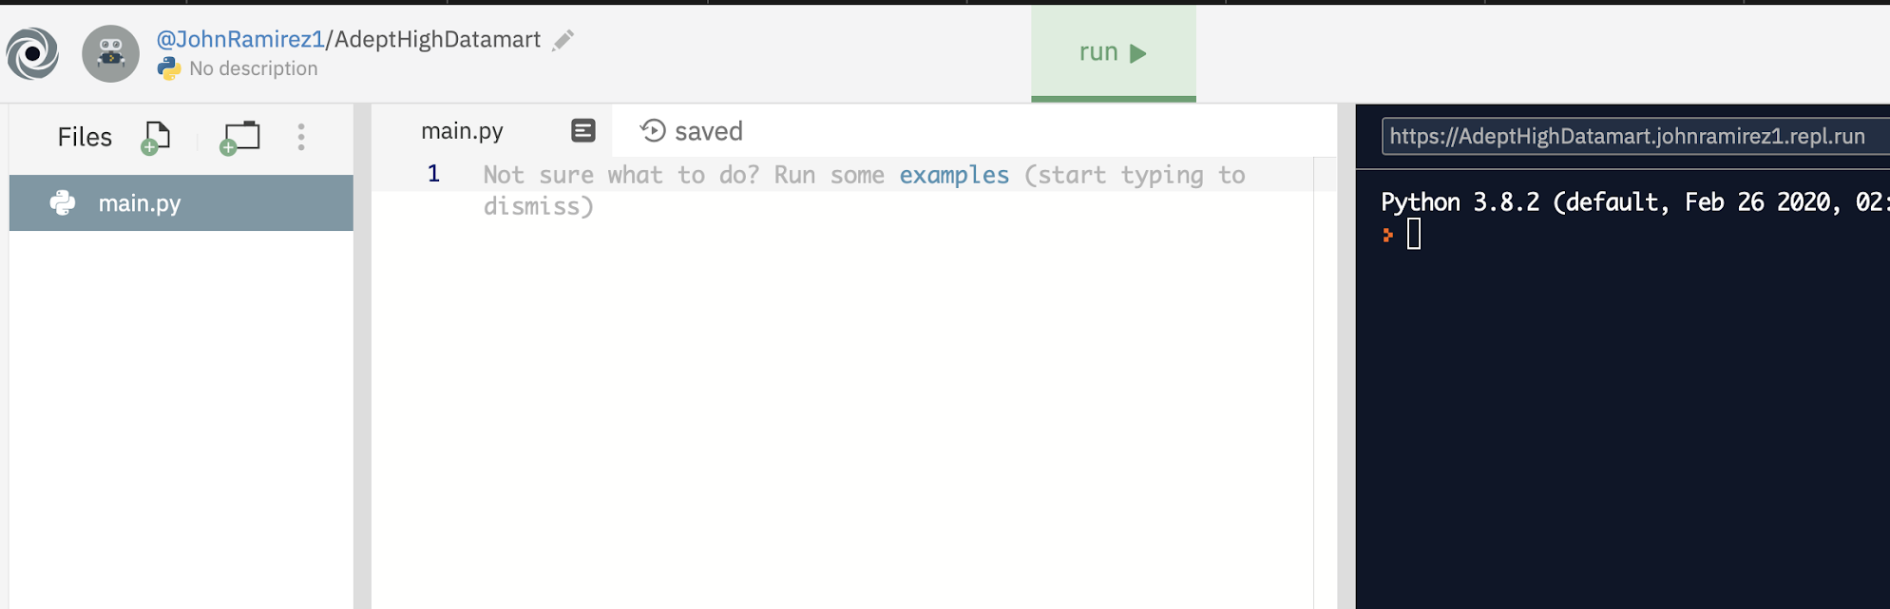
Scratch
Repl.it
This is where you click to start (run) your program

Slide 11
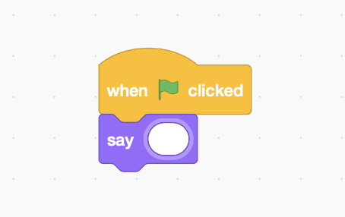
Scratch
Python
print( )
Anything that goes inside the parenthesis will be appear as a message

Slide 12
Anything that is not in code (or a number) has to be in quotes.
print(hello, world)
The computer will think that hello, world is a Python code, causing an error message to appear

Slide 13
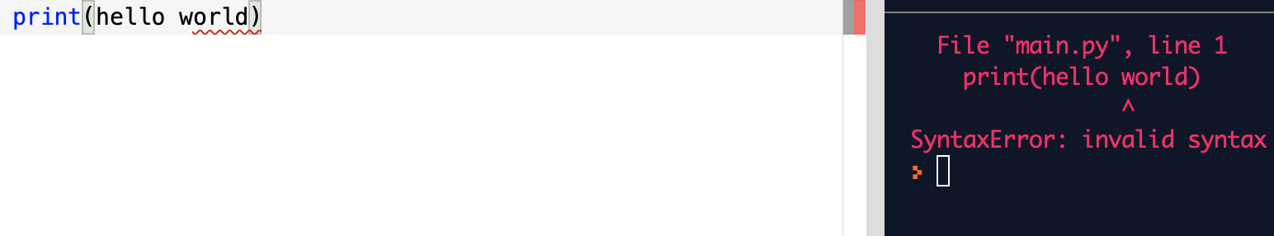
This is the computer’s fancy way of saying:
hello, world is not Python code.
Please try again

Slide 14
When anything is not meant to be in Python code, use quotes
print(“hello, world”)
The computer now knows that “hello, world” is not Python code. It will now print “hello, world”

Slide 15
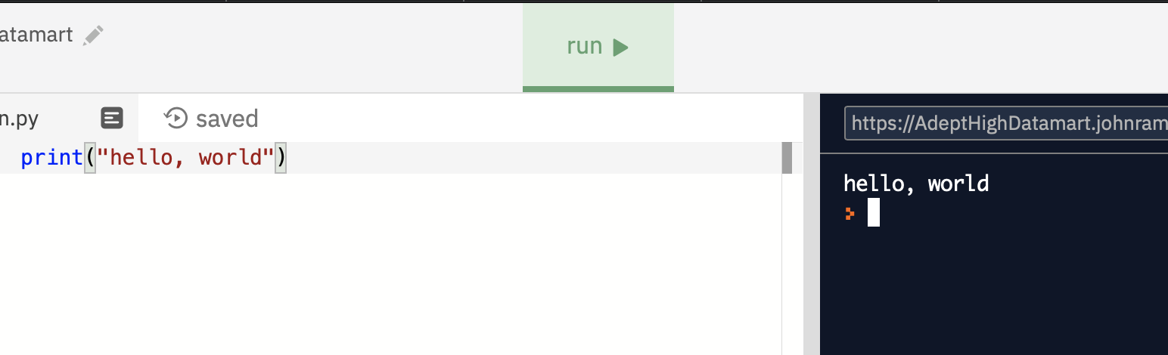
Write this code
Click “run”
A message should appear

Slide 16
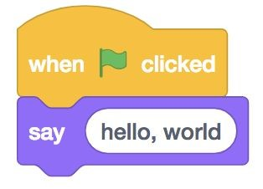
Scratch
Python
print(“hello, world”)

Slide 17
Write a line of Python code that will
print “Hello, Junior Jellies!”
After that, write a line of Python Code that will print “Hello, “ and you name.

Slide 18
You don’t need quotes for numbers
Python knows the difference between Python code and numbers
print(5)
Python will print 5
Python knows that 5 is a number so you don’t need quotes

Slide 19
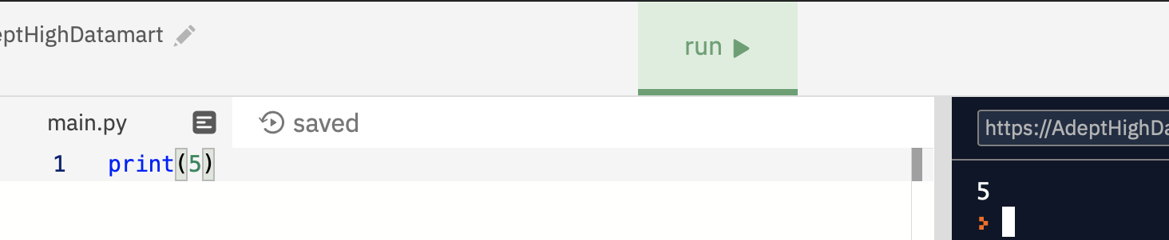
Write this code
Click “run”
5 should appear

Slide 20
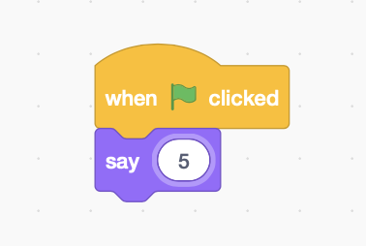
Scratch
Python
print(5)

Slide 21
Scratch
Python
print(“5”)
Numbers can also be in quotes though it is not necessary. Use numbers without quotes when you can

Slide 22
Write a line of Python code that will
print “Hello, Junior Jellies!”
After that, write a line of Python Code that will print “Hello, “ and you name.

Slide 23
Coding Lesson
How was Python able do
print(“Hello, World”) and print(5),
but can’t do print(hello, world)?

Slide 24
Coding Lesson
Think about your name and age.
Is it possible to have your name be a number?
Is it possible to have your age to have a letter?

Slide 25
Coding Lesson
Your name can’t have a number
Your name can’t have a letter in it
Your name and age have two different types of values.
Your name is a value with a bunch of letters
Your age is a value with a number

Slide 26
Coding Lesson
Python also needs to tell between different types of values

Slide 27
Coding Lesson
In Python:
A value that has a “quotation mark” is called a
String (Str)

Slide 28
Coding Lesson
Examples of Strings
“Hello, World”
*** ‘Hello, Junior Jellies’ ***
“How are you doing today?”
‘I am doing great today’

Slide 29
Coding Lesson
In Python:
A value that has a number with no decimal point is called an
Integer

Slide 30
Coding Lesson
Examples of Integers
1
123
150283
0
-12

Slide 31
Coding Lesson
These are not integers
123.4
0.12311234
0.23412
12.4124

Slide 32
Coding Lesson
String and Integers are called data types
Don’t worry about memorizing all of these new terms
We will practice and use these terms often

Slide 33
Coding Lesson
There are more different types of values in Python
We will go over these later
We are going to practice using Strings and Integers

Slide 34
Coding Lesson
“Hello, World” is a String
5 is an Integer
hello, world is not a String nor Integer

Slide 35
Do now:
Write two lines of code
One line of the code should print a String value (create your own String value)
One line of the code should print an Integer
(create your own Integer value)

Slide 36
Remeber the slides with the boxes from
last lesson?
Remember variables?
Python also has variables

Slide 37
Just like when we print, the value of the variable must be a specific data type
(String or Integer)
name = Python
name = “Python”
There is no quotes, so Python doesn’t know what type of value Python is.
An error will appear
There are quotatiton marks, so Python knows that “Python” is a String
The variable name is now equal to “Python”

Slide 38
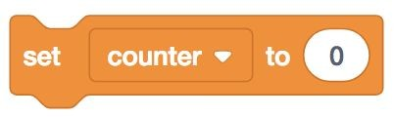
Scratch
Python
counter = 0
In Scratch, we were able to make a variable called counter and set the value of counter equal to zero
The name of the variable
The value of the variable (This is an Integer)

Slide 39
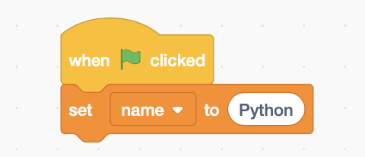
Scratch
Python
name = “Python”
In Scratch, we were able to make a variable called counter and set the value of name equal to Python
The name of the variable
The value of the variable (This is a String)

Slide 40
How do we print variables in Python?

Slide 41
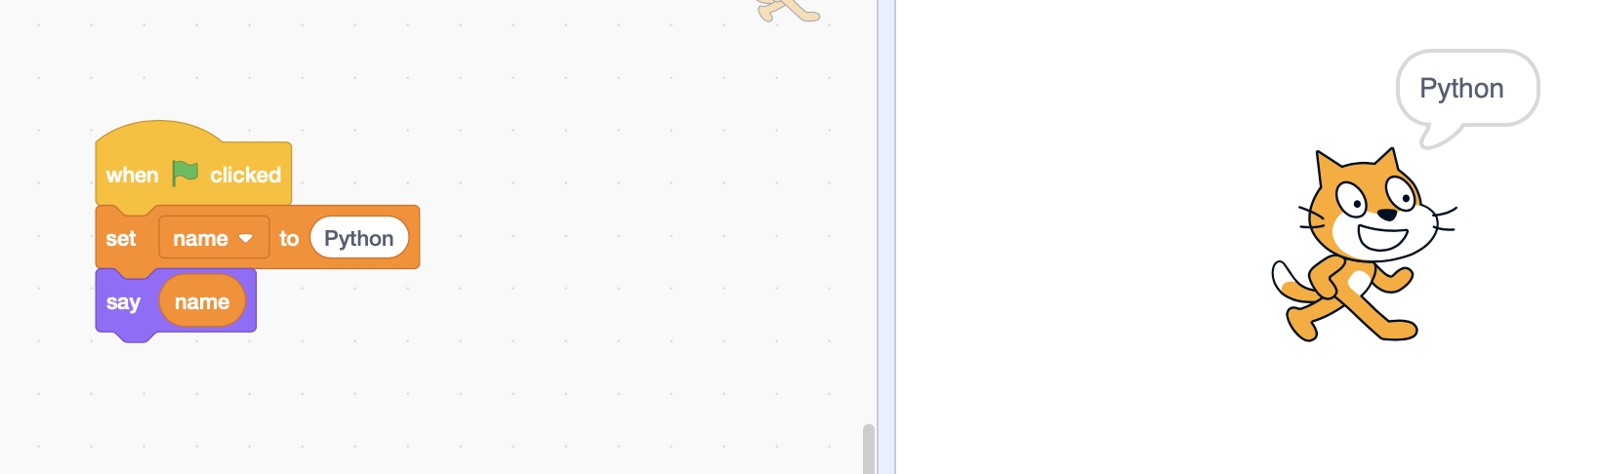
If this is how we do it in Scratch, how does Python do it?

Slide 42
First, make the variable
name = “Python”
print(name)

Slide 43
But the value inside print() must have quotation marks right?
When you have a variable, you don’t need any quotation marks
Why?

Slide 44
name = “Python”
name is a variable that holds a String value
Python knows that name is a String variable, so you don’t need any quotes

Slide 45
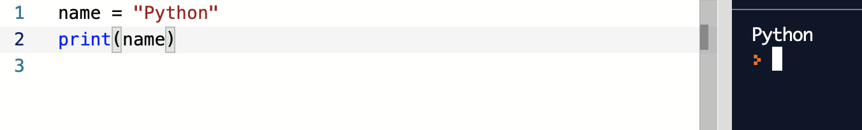
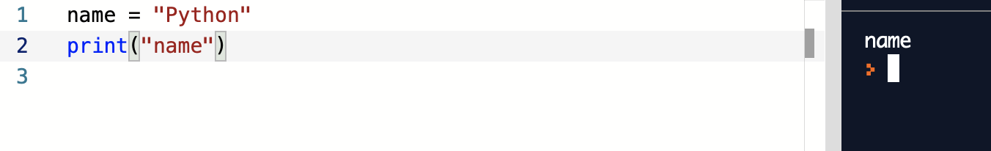
Python Code
Beware

Slide 46
Scratch
Python
See the similairty

Slide 47
Demo:
Write a variable called name. Set name equal to your name.
Then print the variable name.

Slide 48
Demo:
Make a variable called age. Set it equal to your age
Then print the variable age.

Slide 49
How to comment on Python?
Use the # sign

Slide 50
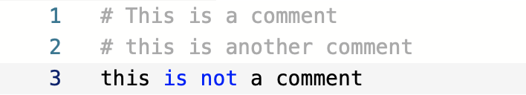

Slide 51
How do we change the value of an integer in Python?

Slide 52
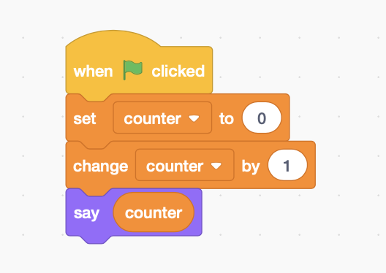
Scratch
Python
counter = 0
counter = counter + 1
print(counter)
***counter is now equal to 1***
***console will print 1***

Slide 53
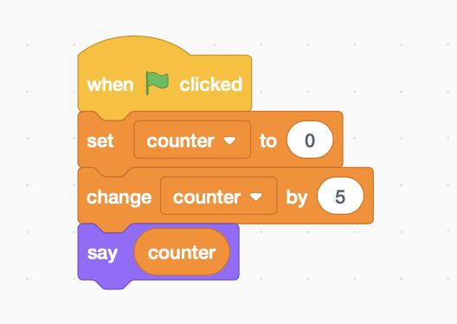
Scratch
Python
counter = 0
counter = counter + 5
print(counter)
***coutner is now equal to 5***
***console will print 5***

Slide 54
Want to see an easier way?

Slide 55
counter = 0
counter += 1
print(counter)
Same thing as
counter = counter + 1
Output: 1

Slide 56
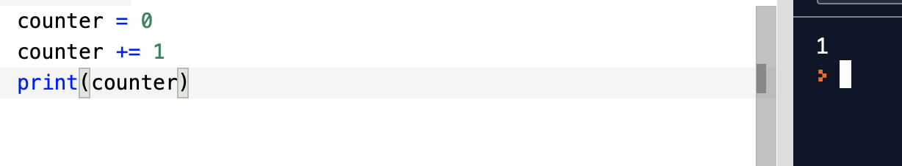

Slide 57
Demo:
Make a variable called score. Add 5 to score.
Print score

Slide 58
How do we make the user type in a value?

Slide 59
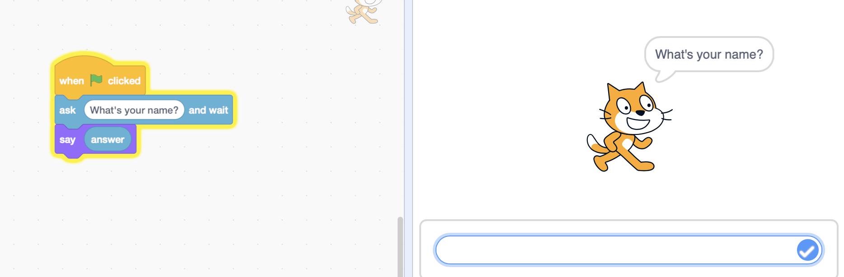
How do we do this in Python?

Slide 60
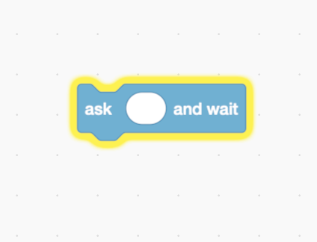
input()

Slide 61
Just like print(),
input() also prints a message
However
input() waits for the user to type a response

Slide 62
We need to save what the user types in a variable
How?
name = input(“What is your name?”)
The program will ask “What is your name?” and will save your name in a variable called name

Slide 63
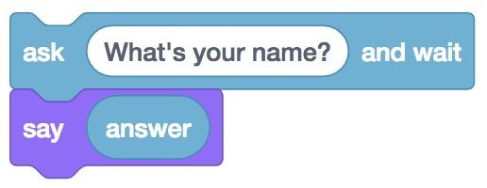
answer = input(“What’s your name?”)
print(answer)

Slide 64
How to get Python to say your name
Make sure to click “Run” first
Then enter your name and enter

Slide 65
Write the code to get Python to ask for your name and then say your name
Then write the code to get Python to ask and then say your age

Slide 66
How do we get Python to say hello to you?
Example: “Hello, Johnny”

Slide 67
We need to combine a string with a variable.
This is very easy to do
Just use a + sign to combine two Strings

Slide 68
“Hello, “ + “Johnny” “Hello Johnny”
name = “Johnny”
print(“Hello, “ + name) “Hello Johnny”

Slide 69
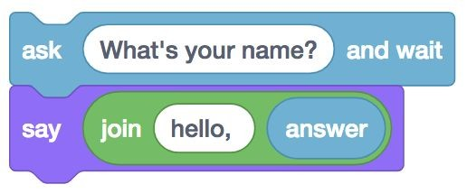
How do we get Python to do this?

Slide 70
name = input(“What’s your name?”)
print(“Hello, ” + name)

Slide 71
Now get Python to say hello to you
Then get Python to ask for your name and print that name

Slide 72
Thank you for joining
Sneak peak for next lesson: mad libs

